Slide 1
Approximate Nearest Neighbor Search

Slide 2
Definition
“Good guess” rather than nearest neighbor:
If there is some point p within distance r of my query point q, I accept any point within distance cr
Why:
Reduce search space
Improve speed
Save memory
r
q
p
cr
p’

Slide 3
Algorithms
Locality-Sensitive Hashing
Best bin first
Balanced box-decomposition trees

Slide 4
Locality-Sensitive Hashing for ANN
Hash data to a smaller number of “buckets” randomly
Nearest points will be more likely to sit in the same bucket
Given a query point, only search neighbors within same bucket

Slide 5
LSH formal definition
Family of hash functions is LSH with (r,cr,p₁,p₂) where p₁≥p₂, c>1 if:
Pr[h(x)=h(y)]≥p₁ when d(x,y)≤r (near points)
Pr[h(x)=h(y)]≤p₂ when d(x,y)≥cr (far points)
Where:
d is a distance measure (Euclidean, cosine, Hamming…)
h is a hash function in the family
x and y are “points” (in multiple dimensions)

Slide 6
Example: bit sampling for Hamming space
Build a family of hash functions for binary vectors of n elements where:
h_{i}(x)=x_{i}
The i-th hash function outputs the i-th bit of x
Hamming Similarity = bit_count (x and y) = n. of identical bits
Hs=n-Hd
Bit sampling forms a LSH family for Hs
Pr[h(x)=h(y)]≥1-r/n if d(x,y)≤r
Pr[h(x)=h(y)]≤1-cr/n if d(x,y)≥cr

Slide 7
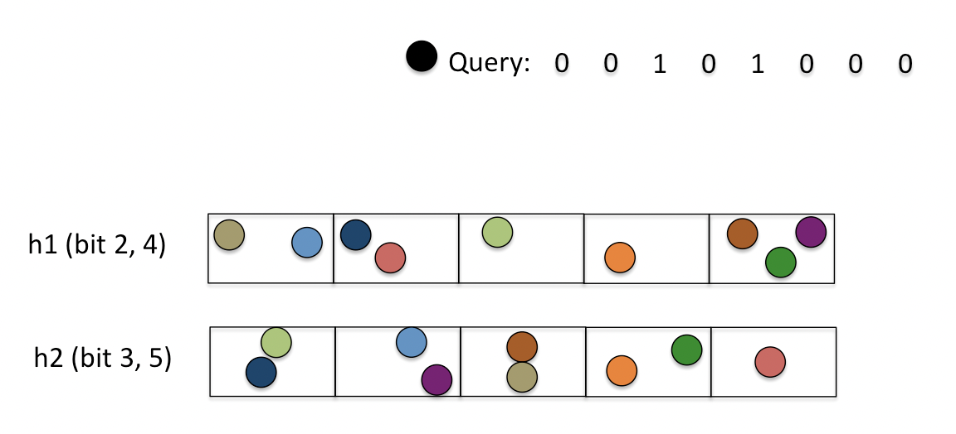
Approx. NN with LSH for Hamming Similarity
C.J. Hsieh, UCDavis, 2016
For each h_{i} function in a set of m, sample k elements and map to 2^{k} buckets
Two points q and p collide (i.e. are similar) if h_{i}(q)=h_{i}(p) for some i=1..m
Search only among points that collide with the query (i.e. compute Hd and sort)
h1
h2
Compare black query point only with:
Blue point in bucket found by h1
Orange point in bucket found by h1 and h2

